Slide 1
Password Authentication
Thomas Cutsforth

Slide 2
Introduction
The world is reliant on the Internet and online data storage to keep information more than ever.
Keeping important/confidential information from being stolen from a Cyberattack should be a top priority when assessing risks.
Passwords have been an industry standard for decades yet has seen little changes to minimize risks.
Needs vary depending on user, company, etc. Many options are available to convert for your own accommodations. What works for some, may not work for others.

Slide 3
Possible Solutions:
Graphical Passwords
“Smart Card” Approach
Tweaking the Current Standards to Improve Security

Slide 4
Graphical Passwords
Examples
Pros
Cons
reCAPTCHA Puzzles
“Draw-A-Shape” password
Android Phone feature
Pattern of Images
Not word-based (removes threat of “dictionary attacks”)
User-Friendly
Memorable
Sequence of images
Position of images
Can still be broken by brute force
Traced by smudges on mobile devices
Not Time Efficient

Slide 5
Implementing A Graphical Password (Jermyn, 1999)
Textual Based With Graphical Assistance
User enters a 1-word password, then asked to transform it however they wish
Ex. T O M A T O → T A O T M O (went in order from even indexes to odd indexes)
Draw A Secret
Creates a rectangular grid, allow user to click and drag to create the path.
Save coordinates into a set to show what path the user chose
Allows some room for error for consistency

Slide 6
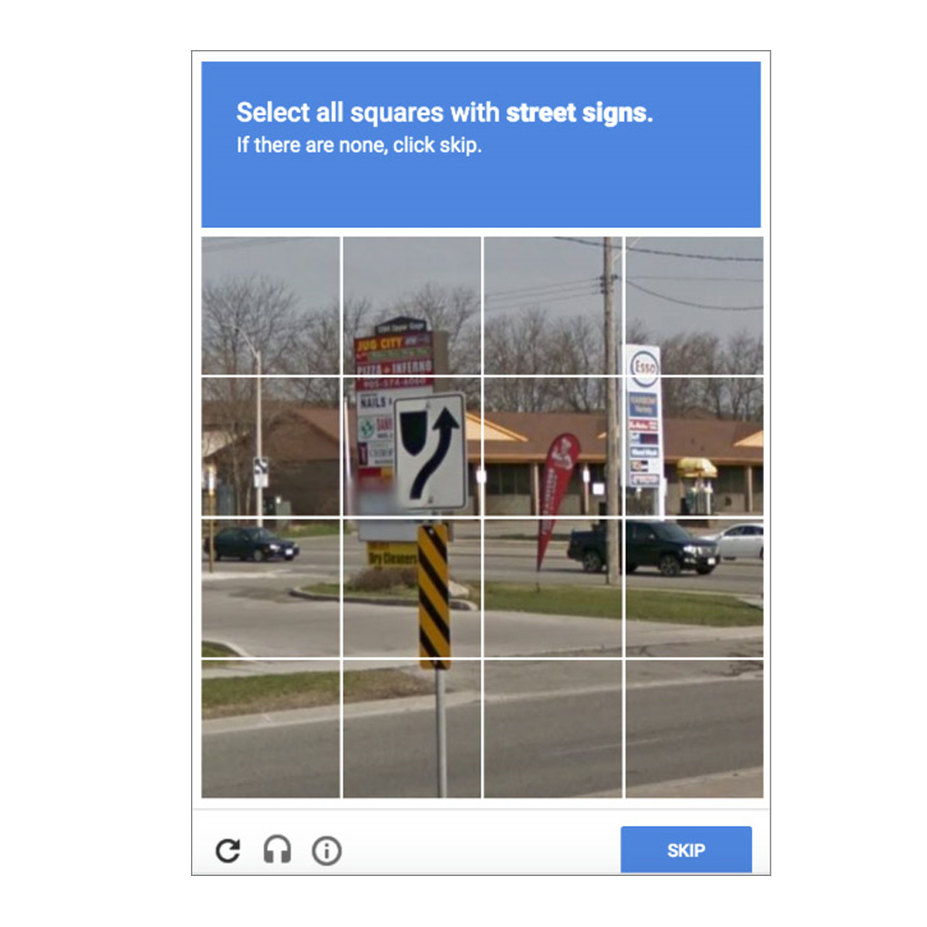

Slide 7
Smart Card Passwords
Examples
Pros
Cons
Physical Cards
Debit/Credit Cards
SIM Card (for data storage)
Virtual Cards
Microsoft
Other 3rd party software
2 Factor (user credentials and PIN/Password)
Low Cost to implement
User friendly
PIN Number or Standard Password protocol
Multiple implementation methods possible
If implemented as a physical card, potential for loss/damage
Offline guessing attacks or server hacking possible
Password/PIN not saved but personal information is

Slide 8
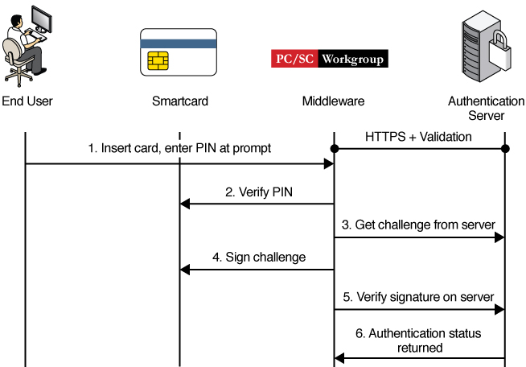
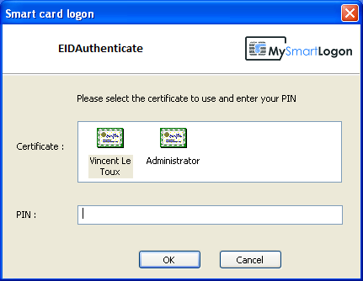

Slide 9
Implementing A Smart Card Password
2FA with standard Password Based Authentication (Yang et al, 2008)
Use of hash functions that are efficient in time and space complexity with pseudo-random identification parameters to encrypt user information and to make the system more secure.
Most virtual Smart Card Implementations work the same, with the main differences coming from security functions.
Physical Card scheme

Slide 10
Improving Current Standards
Combination of Ideas
Other Ideas
Three Factor Authentication (Lakshmi, 2018)
Standard Alphanumeric Password
Graphical Password
Random Security Question from registration
This idea combines 3 very common authentication methods to create an even more secure login experience than 2FA. This is very easy to implement and is most notably used in Online Banking scenarios.
Image Patterns (Sepideh, 2019)
Grid of images, select a group of pictures in order
Not time/space efficient due to many image files to use

Slide 11
References
Adama, V. N., Noel, M. D., Yisa, V. L., Meshach, B., & Ayobami, E. (2018). Password knowledge versus password
management. I-Manager's Journal on Computer Science, 6(3), 16-24. doi:https://doi.org/10.26634/jcom.6.3.15697
Anwar, M., & Imran, A. (2015). A Comparative Study of Graphical and Alphanumeric Passwords for Mobile Device Authentication. In MAICS (pp. 13-18).
Devasena, C. L. (2018). Three-Factor Authentication for Fortified Login to Ensure Privacy Preservation and Improved Security. International Journal of Applied Engineering Research, 13(10), 7576-7579.
Jermyn, I., Mayer, A., Monrose, F., Reiter, M. K., & Rubin, A. (1999). The design and analysis of graphical passwords. In 8th USENIX Security Symposium (USENIX Security 99).
Sepideh, F. (2019). 'Providing a Secure Hybrid Method for Graphical Password Authentication to Prevent Shoulder Surfing, Smudge and Brute Force Attack'. World Academy of Science, Engineering and Technology, Open Science Index 156, International Journal of Computer and Information Engineering, 13(12), 624 - 628.
Yang, G., Wong, D. S., Wang, H., & Deng, X. (2008). Two-factor mutual authentication based on smart cards and passwords. Journal of computer and system sciences, 74(7), 1160-1172.

